Slide 1
SECURE INFORMATION SHARING USING QR-CODE

Slide 2
ABSTRACT
Now a days QR-CODE quick response code has many uses in handling information. So we can use this for passing information to a receiver in QR-CODE form so the receiver can scan and read the information. We can pass a limited and useful information using QR-CODE in a secure way. By using security pins same as Ex: UPI transaction we can give a secure pin for our information which we want to share Only the person who knows the pin can read information which is shared by sender In this project QR-code generation is done using program with a security pin known only by receiver. Password-protected QR code allows you to display a QR code in a public area while being able to regulate and restrict other scanners except for the authorized ones. You can share your QR code password with those people whom you want to share the content with, making them the only ones who can access and view the content of your QR code. This QR code is great for sharing confidential documents or exclusive content. QR Code can hold any information within the square code. It can be used to link to a text, business card, multimedia, social media channels, and marketing campaigns. QR Code can hold up to 7,089 characters allowing it to be more versatile than a barcode. QR Codes resist damage. QR Codes can go through wear-and-tear and the agenda of the QR Code can be changed if dynamic QR Codes are used. QR Codes can support multimedia content– video, audio, and even AR and VR.

Slide 3
eXISTING SYSTEM
The QR technology offers a convenient way to share content, we can change information in to QR code and we can scan and retrieve the information by scanner. In upi transactions money can be transferred from bank to bank with a secured pin but now we are proposing a new system to transfer information.

Slide 4
PROPOSED SYSTEM
In this proposed system, when people scan a password-protected QR code, they will be redirected first to a webpage where they have to enter the password of the QR code. After submitting the password, the scanners will be able to access and view the content stored on the QR code.

Slide 5
MODULES
1)Py QR module
2)URL in code
3)Generating QR
4)Validation
5)Information

Slide 6
Py QR module in python
The pyqrcode module is a QR code generator that is simple to use and written in pure python. The module can automates most of the building process for creating QR codes.

Slide 7
URL in code (Adding Url in code)
Uniformed resource locater link is added in the program and converted in to QR code where information meant to be retrieved after scanning will be in form of URL is added to program. Example: https://www.computerhope.com

Slide 8
Generating QR code (from Url added to code)
Our program generates the QR code by taking URL as input and gives QR code as output you want to use a QR Code but restrict access to it at the same time.

Slide 9
Validation (our system will verify credentials)
Receiver need to enter the correct pin provided by sender to retrieve the information if receiver enters wrong pin our validation software will block the receiver. Once your password protected QR Code has been created, you can share the password with the authorized personnel. And ask them to use it to access the encoded data.

Slide 10
Information (our valuable information will be retrieved here)
After entering the pin provided by sender the receiver can retrieve the information.
Password protected QR Codes allow you to share your private data with only authorized people. When end-users scan it, they are prompted to enter the required password to be able to access the data. That simple!

Slide 11
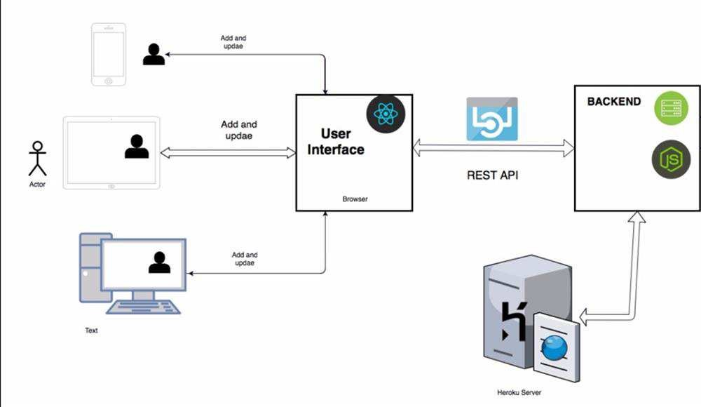
APPLICATION ARCHITECTURE DESIGN

Slide 12
UML DIAGRAMS

Slide 13
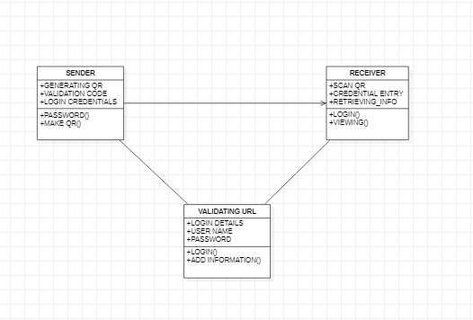
cLASS DIAGRAM

Slide 14
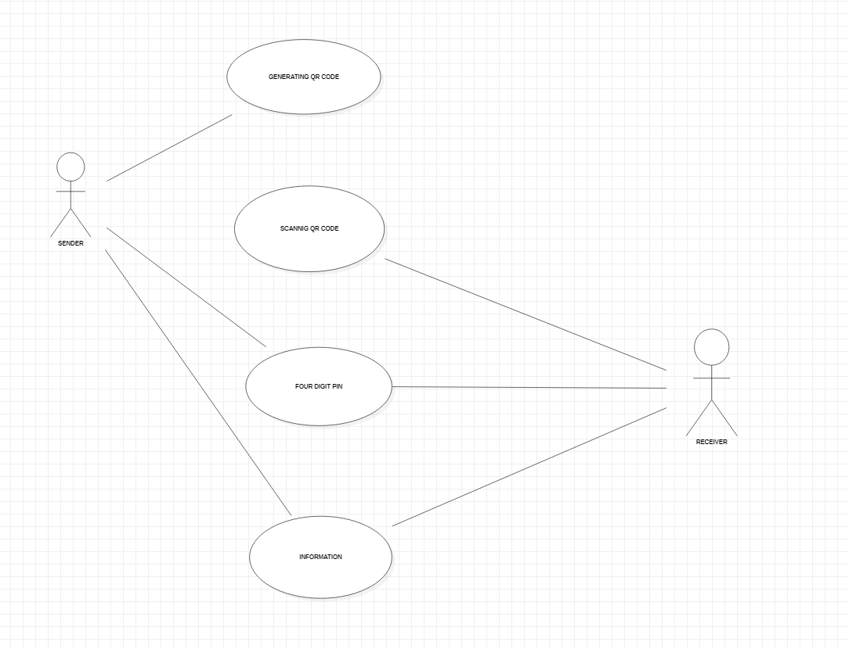
USE CASE DIAGRAM

Slide 15
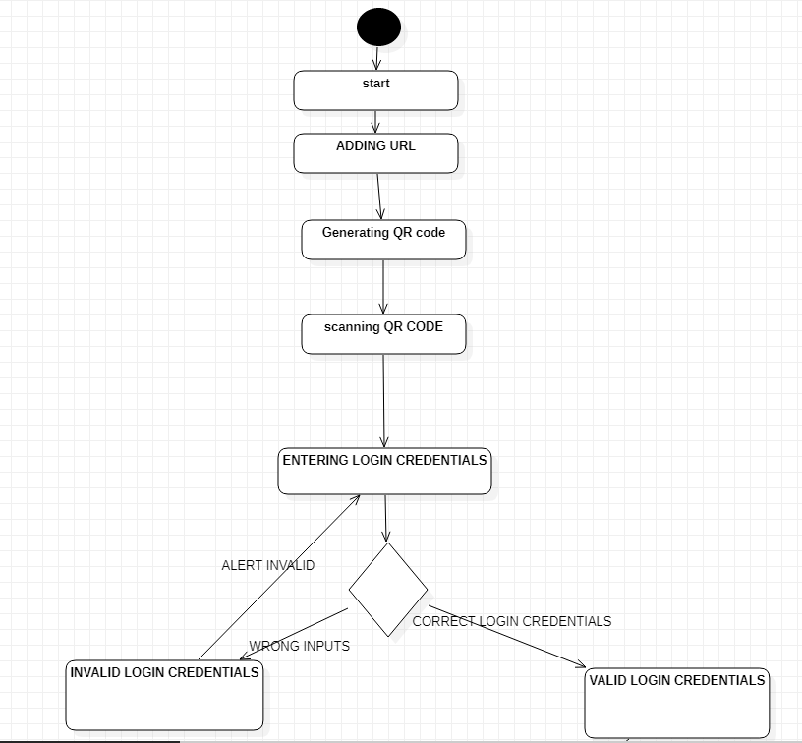
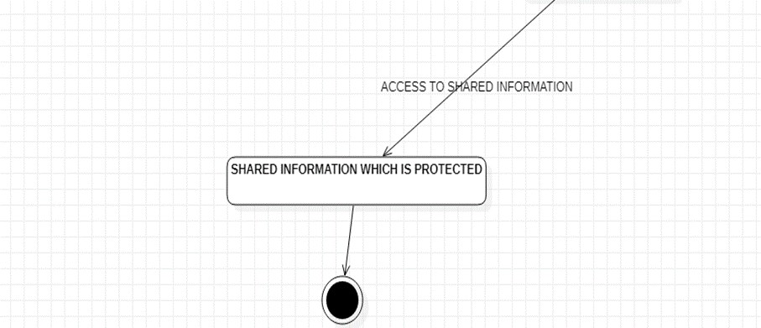
ACTIVITAY DIAGRAM

Slide 16
sample screen shots

Slide 17
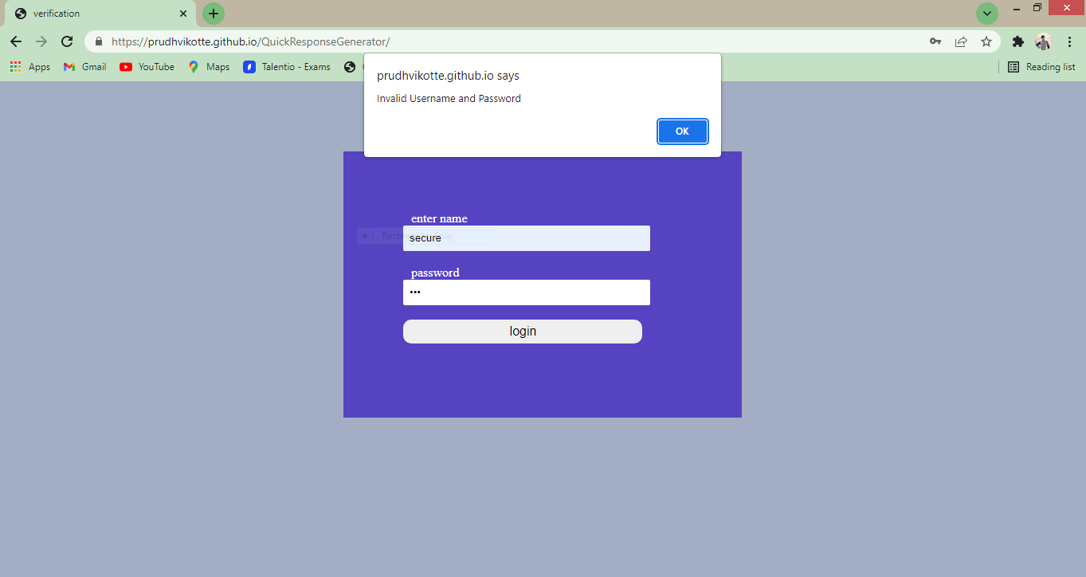
login form

Slide 18
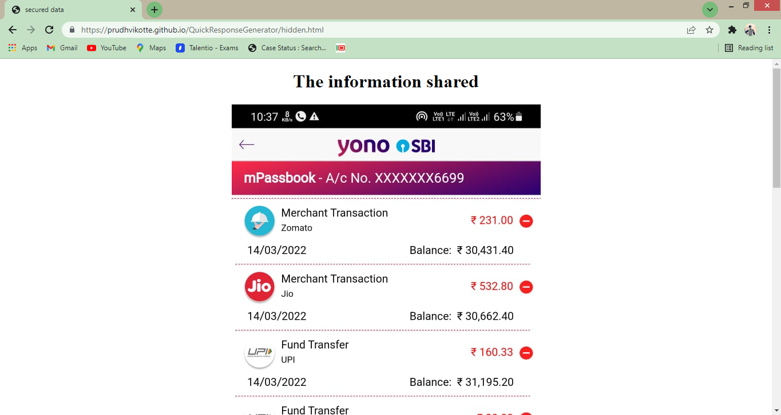

Slide 19
Test case for Login form:
When a user tries to login by submitting an incorrect ID or an incorrect Passwordthen it displays an error message “USERNAME OR PASSWORD IS INCORRECT”.

Slide 20
CONCLUSION AND FUTURE ENHANCEMENTS

Slide 21
These QR codes were initially used to replace the traditional barcodes in tracking manufactured car parts with a fast-reading code.QR codes nowadays are used in a much larger context. They are used in tracking commercial products, marketing campaigns, and other convenience- oriented processes that target smartphone users.
QR codes are two-dimensional barcodes that store complex data. Unlike the traditional barcodes that can only store and display alphanumeric data, QR codes can display a website, file, or social media accounts.
These QR codes are now used in cashless payments, easy access menus, for a more engaging marketing campaign, and many more.
With these QR code features, we can truly say that QR codes have limitless potential. The content that is stored in the QR code can be accessed by just scanning these QR codes using smartphones. Making the QR code content and the information easily accessible by all.

Slide 22
Problems arising in the existing system:
1.but how about the content and information that you only want to share with specific people?
2.How can you limit the accessibility of the QR code and allow specific people to access the QR code content?
SOLUTION: We can regulate your QR code viewers and allow only your target viewers to access your QR code by integrating a password on your QR code.

Slide 23
FUTURE ENHANCEMENTS
Password-protected QR codes are QR codes in which the content or information stored in the QR code can only be accessed and viewed after the scanners entered the right password. When people scan a password-protected QR code, they will be redirected first to a webpage where they have to enter the password of the QR code. After submitting the password, the scanners will be able to access and view the content stored on the QR code. The password feature can also be disabled allowing a larger audience to access the QR code content whenever you want.
.

Slide 24
REFERENCES
General
Online Tutorials and Resources
1.Mozilla’s (MDN) "JavaScript Guide"
@ https://developer.mozilla.org/en-US/docs/Web/JavaScript/Guide.
2.W3School JavaScript Tutorials, References and Examples @ http://www.w3schools.com.
WEB SITE:
1. Google developer API, "Computing with QR CODE: Build smart applications using artificial intelligence as a service".

Slide 25
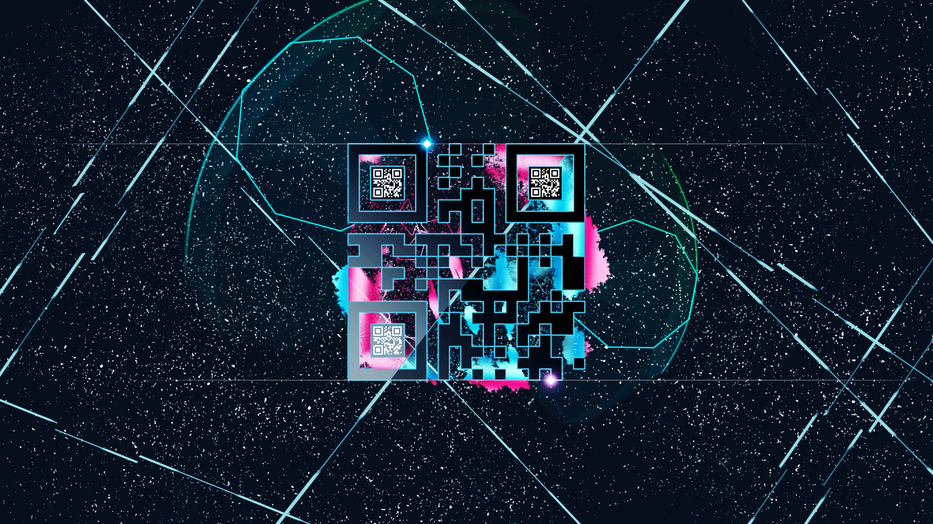
Thanks!

Slide 26



Team Presentation
K. Prudhvidhar Rao
18911A1237
MN. Varun Tej 18911A1240
P. Nithish Reddy 18911A1245

